Slide 1
UNIT V - SPECIAL ICs

Slide 2
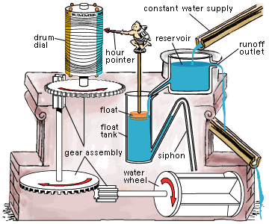
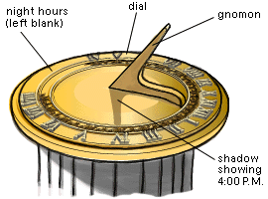
A brief look back in time
Clepsydra from about 15th century B.C
Sundial from about 16th century B.C.
Astrolabe from about 2nd century A.D.

Slide 3
A brief look back in time
Candle Clock from about 9th century A.D.
Hour Glass came probably from Europe before the 14th century.

Slide 4
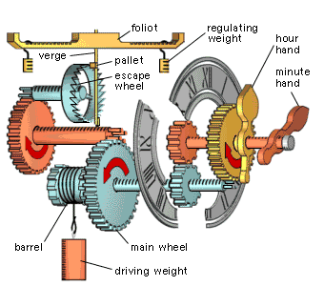
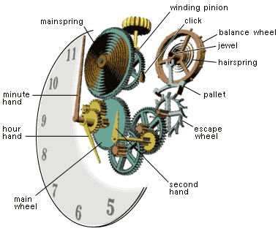
A brief look back in time
Weight driven clock from
1270s and probably Europe.
Spring driven clock from around 15th century A.D.

Slide 5
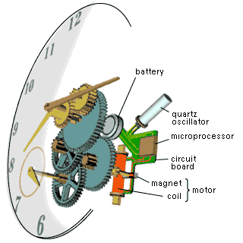
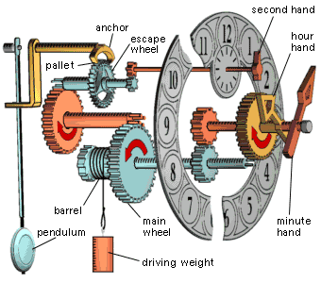
A brief look back in time
Pendulum Clock in 1656
Quartz watch in 1927

Slide 6
A brief look back in time
Cesium atomic clock
Britain's National Lab 1955

Slide 7
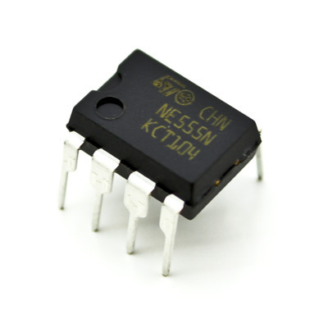
555 TIMER

Slide 8
555 Timer
Introduction:
The 555 Timer is one of the most popular and versatile integrated circuits ever produced!
“Signetics” Corporation first introduced this device as the SE/NE 555 in early 1970.
It is a combination of digital and analog circuits.
It is known as the “time machine” as it performs a wide variety of timing tasks.
Applications for the 555 Timer include:
Ramp and Square wave generator
Frequency dividers
Voltage-controlled oscillators
Pulse generators and LED flashers

Slide 9
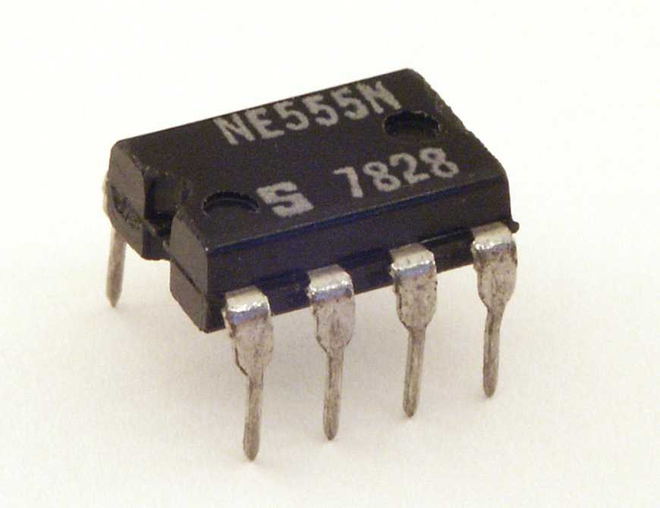
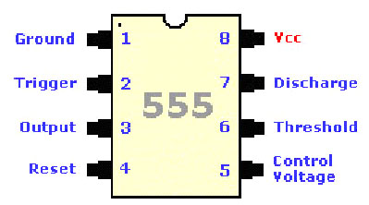
555 timer- Pin Diagram
The 555 timer is an 8-Pin D.I.L. Integrated Circuit or ‘chip’
Notch
Pin 1

Slide 10
555 timer- Pin Description
Pin | Name | Purpose
1 | GND | Ground, low level (0 V)
2 | TRIG | OUT rises, and interval starts, when this input falls below 1/3 V_{CC}.
3 | OUT | This output is driven to approximately 1.7V below +V_{CC} or GND.
4 | RESET | A timing interval may be reset by driving this input to GND, but the timing does not begin again until RESET rises above approximately 0.7 volts. Overrides TRIG which overrides THR.
5 | CTRL | "Control" access to the internal voltage divider (by default, 2/3 V_{CC}).
6 | THR | The interval ends when the voltage at THR is greater than at CTRL.
7 | DIS | Open collector output; may discharge a capacitor between intervals. In phase with output.
8 | V+, V_{CC} | Positive supply voltage is usually between 3 and 15 V.

Slide 11
555 Timer
Description:
Contains 25 transistors, 2 diodes and 16 resistors
Maximum operating voltage 16V
Maximum output current 200mA
Best treated as a single component with required
input and output
INPUT
PROCESS
OUTPUT

Slide 12
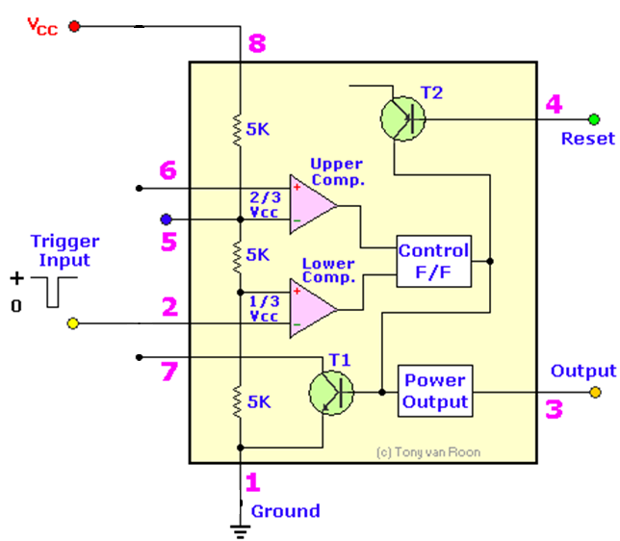
Inside the 555 Timer
+
Truth Table
Vref
S | R | Q | Q
0 | 0 | No Change
0 | 1 | 0 | 1
1 | 0 | 1 | 0
1 | 1 | X | X
Threshold
Control Voltage
R
Q
-
S
Q
Trigger
Discharge
Functional Diagram of 555 Timer

Slide 13
Inside the 555 Timer
Operation:
Voltage divider - three equal 5K resistors - divides the input voltage (Vcc) into three equal parts.
Two comparators - op-amps - compare the voltages at their inputs and saturate depending upon which is greater.
Threshold Comparator - saturates - when the voltage at the Threshold pin (pin 6) is greater than (2/3)Vcc.
Trigger Comparator – saturates - when the voltage at the Trigger pin (pin 2) is less than (1/3)Vcc

Slide 14
Inside the 555 Timer
Flip-flop is a bi-stable device - “high” : Vcc and “low”: 0V.
Threshold comparator saturates - FF is Reset (R) - outputs a low signal at pin 3.
Trigger comparator saturates- FF is Set (S) - outputs a high signal at pin 3.
Transistor - used as a switch - connects pin 7 discharge to ground when it is closed.
Q is low, Q bar is high - closes the transistor switch - attaches pin 7 to ground.
Q is high, Q bar is low - opens the switch and pin 7 is no longer grounded

Slide 15
Brief operation
Low output from the timer:
Voltage on the threshold input must exceed the control voltage or + (2/3) V_{CC}. This also turns the discharge transistor on.
High output from the timer:
Voltage on the trigger input must drop below +(1/3) V_{CC}. This turns the discharge transistor off.

Slide 16
Uses of 555 timer
To switch on or off an output after a certain time delay i.e.
Games timer, Childs mobile, Exercise timer.
To continually switch on and off an output i.e.
Warning lights, Bicycle indicators.
As a pulse generator i.e.
To provide a series of clock pulses for a counter.

Slide 17
Features of IC 555 Timer
1. Monolithic timer device - To produce accurate and highly stable time delays or oscillation (microseconds to several hours)
2. Two basic operating modes: monostable and astable.
3. Three packages: 8-pin metal can, 8-pin mini DIP or a 14-pin.

Slide 18
Features of IC 555 Timer
4. Supply voltage : 4.5v to 18v and output current - 200mA.
5. High temperature stability (-55⁰c to 125ºc)
6. Output is compatible with TTL, CMOS and Op-Amp circuits.

Slide 19
555 Timer operating modes
Three operating modes
1. Monostable Multivibrator
2.Astable Multivibrator
3. Bistable Multivibratior

Slide 20
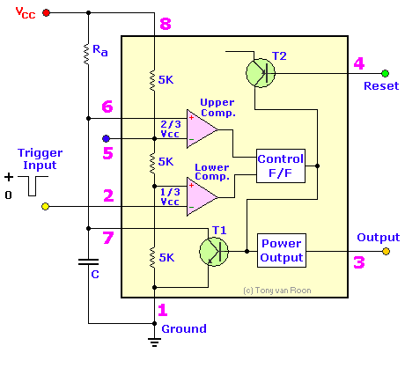
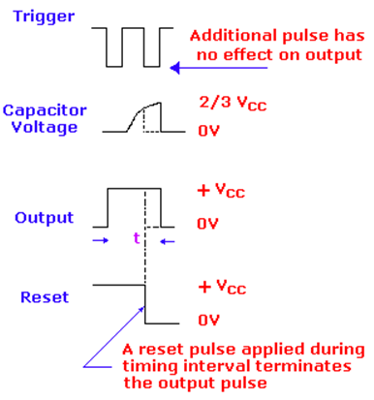
555 Timer as Monostable Multivibrator
Fig (a): Timer in Monostable Operation with Functional Diagram
Fig (b): Output wave Form of Monostable

Slide 21
IC 566 – Voltage Controlled Oscillator

Slide 22
What is Voltage Controlled Oscillator?
Oscillator whose output can be varied over a range - controlled by the input DC voltage.
Output frequency is directly related to the voltage at its input.
Oscillation frequency varies from few hertz to hundreds of GHz.

Slide 23
Types of Voltage Controlled Oscillators
Harmonic Oscillators: The output is a signal with sinusoidal waveform.
Relaxation Oscillators: The output is a signal with saw tooth or triangular waveform and provides a wide range of operational frequencies. The output frequency depends on the time of charging and discharging of the capacitor.

Slide 24
A Practical VCO – LM566
LM566 is a general purpose VCO - to generate square wave and triangular waveforms as a function input voltage.
LM566 is specified for operation over 0˚C to 70˚C temperature range.
The frequency - a linear function of a controlling voltage.
The frequency is also controlled by an external resistor and capacitor, whose values control the free running frequency

Slide 25
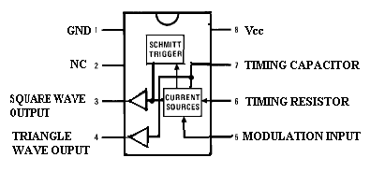
IC 566 – Pin Diagram
Pin 1: Ground (GND)
Pin 2: No connection (NC)
Pin 3: Square wave output
Pin 4: Triangular wave output
Pin 5: Modulation input
Pin 6: Timing resistor
Pin 7: Timing capacitor
Pin 8: Vcc

Slide 26
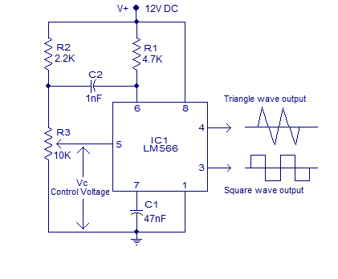
VCO using IC 566

Slide 27
Features of 566
The maximum operating voltage is 10V to 24V
High temperature stability
Operating temperature is 0˚C to 70˚C
The frequency can be controlled by means of current, voltage, resistor or capacitor
Power dissipation is 300mV
Excellent power supply rejection

Slide 28
Applications of VCO
Function generator
Tone generator
FM modulation
Frequency shift keying
Clock generator
Phase Locked Loop

Slide 29
IC 565 – Phase Locked Loop

Slide 30
What is Phase Locked Loop?
A control system that generates an output signal whose phase is related to the phase of an input signal.
Simplest is an electronic circuit consisting of a variable frequency oscillator and a phase detector in a feedback loop.
The oscillator generates a periodic signal, and the phase detector compares the phase of that signal with the phase of the input periodic signal
Adjusting the oscillator to keep the phases matched

Slide 31
What is Phase Locked Loop?
Electronic circuit - to lock the output frequency of the voltage controlled oscillator with the desired input frequency by constantly comparing the phase of the input frequency with that of the output frequency of the VCO.
To generate a signal, modulate or demodulate it.
Mainly used in Frequency modulation and Amplitude modulation.
Basically the output frequency of the voltage controlled oscillator is constantly adjusted until it matches with the input frequency

Slide 32
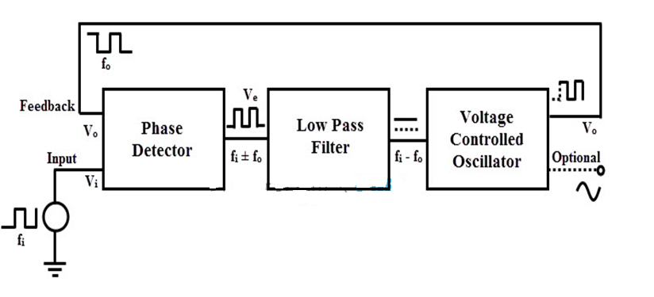
PLL – Block Diagram

Slide 33
How PLL works?
PD or Phase detector compares the output frequency with the input reference frequency.
Incase of any mismatch, the phase detector generates an error signal which is filtered using a low pass filter to remove the noise
This signal is applied to the Voltage controlled Oscillator to accordingly generate the output frequency.
This output frequency is given to the phase detector through a divide by N counter which divides the output frequency by a certain number N.

Slide 34
How PLL Works?
Whenever the frequency of the incoming signal changes, the phase comparator compares frequency of the input with that of oscillator output signal and produces the phase difference signal.
This output is filtered in low pass filter and produce the filter output as V_{control} to control the frequency of the VCO until the frequency and phase difference becomes zero.
At this point the PLL is locked or synchronized to the input frequency. PLLs are used mostly in frequency synthesis and frequency modulation applications

Slide 35
PLL -Applications
Analog building blocks used in many digital and analog applications.
Used in clock recovery in many digital and communication systems
Frequency synthesizers in television and wireless communication systems to select various channels

Slide 36
PLL -565 Characteristics
Operating frequency range: 0.001 Hz to 500 kHz.
Operating voltage range: ± 6 to ± 12 V.
Input impedance: 10 k Q typically.
Output sink current: 1mA typically.
Output source current: 10 m A typically.
Drift in VCO centre frequency with temperature: 300 ppm/ °C typically.
Drift in VCO centre frequency with supply voltage: 1.5 %/V maximum.
Input level required for tracking: 10 mVrms minimum to 3 V peak-to-peak maximum.
Bandwidth adjustment range: < ± 1 to > ± 60 %.

Slide 37
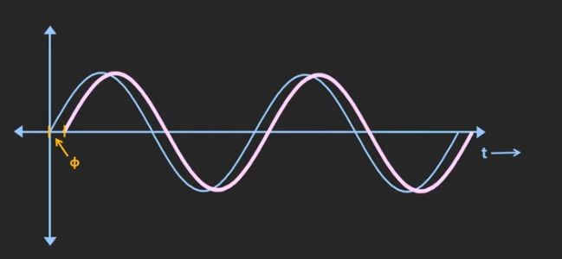
Phase Locked Loop(PLL)
PLL is feedback system maintains a constant phase angle between two signals with reference to control signal.
The operation of a phase locked loop, PLL, is the phase diﬀerence between two signals, and the ability to detect it.
Error in phase or the phase diﬀerence between the two signals is then used to control the frequency of the loop.

Slide 38
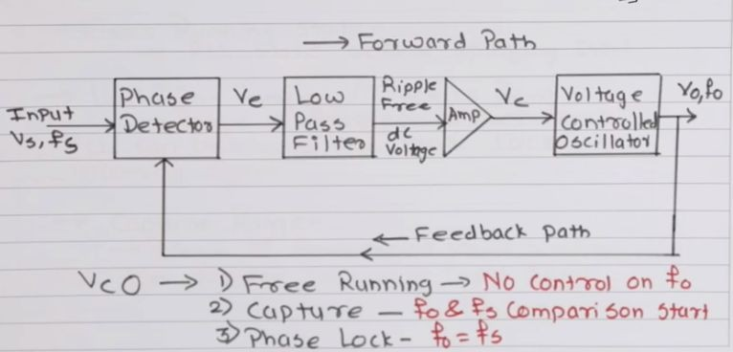
PLL-Block Diagram

Slide 39
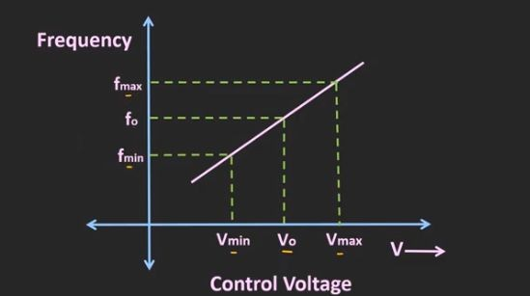
Phase comparator / detector: This circuit block within the PLL compares the phase of two signals and generates a voltage according to the phase diﬀerence between the two signals.
Low Pass Filter: Used to frequency components frequency.
pass through low and stops high
Ampliﬁer : To amplify the error voltage
VCO: An Electronic Circuit in which output frequency varies with input voltage( f o and Vc)

Slide 40
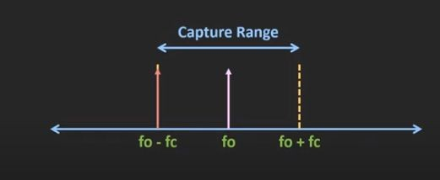
Free running Mode: No control on fo( before applying VC )
Capture Range: The range of input frequencies over which PLL will capture the input signal i
Lock Range: The range of input frequencies over which PLL remains in lock condition once it captured the input signal.

Slide 41
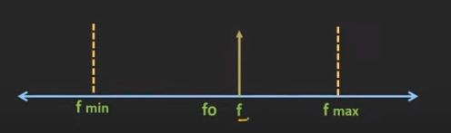
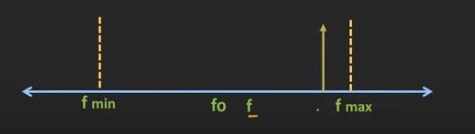
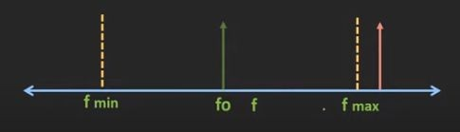

Slide 42
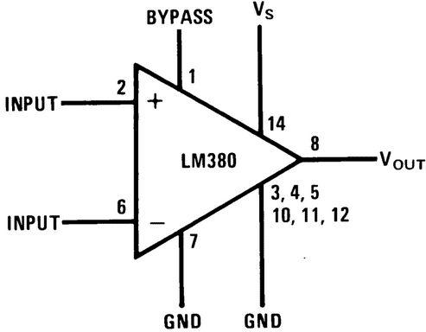
LM 380 Power Audio Amplifiers

Slide 43
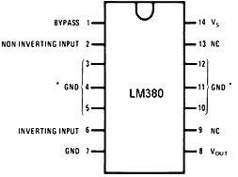

Slide 44
National Semiconductor produces two popular IC audio power amplifiers LM380 and LM384. The LM380 is designed to deliver 2.5W (r.m.s) to a capacitively coupled 8 load whereas LM384 can deliver 5W power and both are available in DIP packages.

Slide 45
A copper lead frame is used with the central three pins (3, 4, 5, 10, 11, and 12) on either side of the DIP package forms the heat sink. Thus there is no need to separate heat sink. The IC can be used in inverting and non-inverting configurations. The inverting terminal can be either shorted to ground, left open or returned to ground through a capacitor or a resistor

Slide 46
The capacitor C₂ is used to cancel the effects of the inductance in the power supply leads. A lag compensating RC network must be connected from output to ground to avoid oscillation

Slide 47
The gain of the LM380 is internally fixed at 50 but it is possible to get he gain increased up to 300, using positive feedback. There are also available hybrid power amplifiers which supply more output power than is possible using monolithic power ICs.

